Slide 1
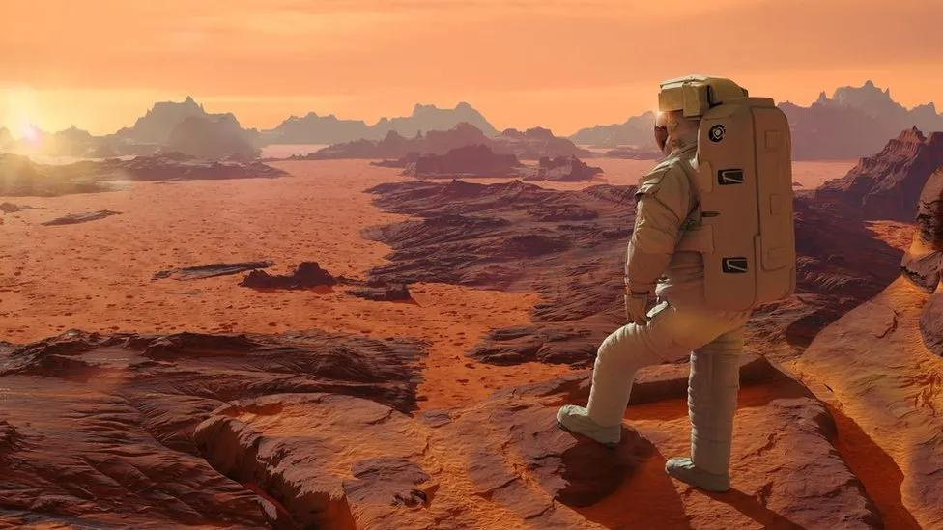

LA TIERRA
HUMAN
EXPLORATION
THE JOURNEY OF A ROVER TO MARS

Slide 2



Planning
01
Why mars ?
02
Challenges
02
03
03
Human exploration rover
04
Conclusion & Perspectives
04
01

Slide 3

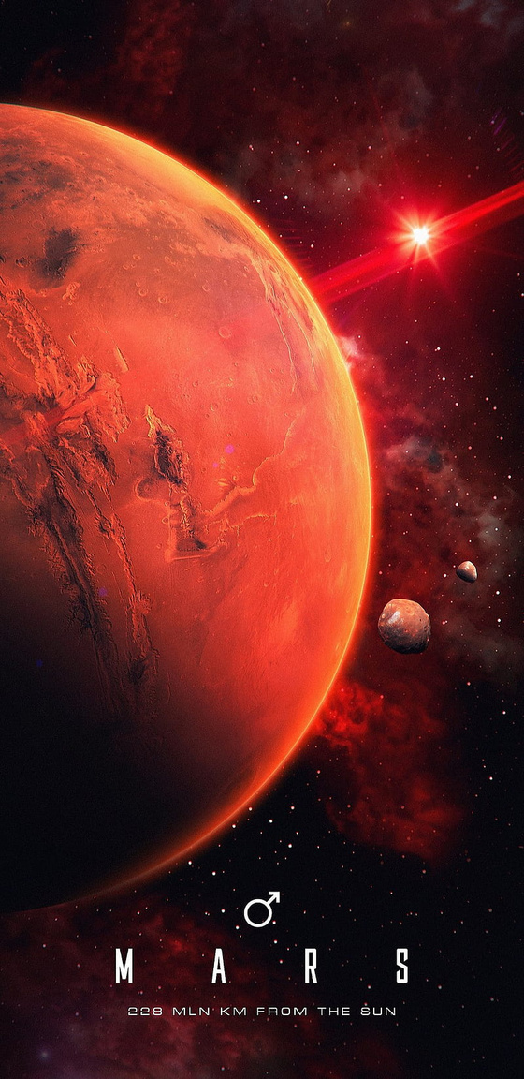


Why we chose mars?
Mars is our closest planetary neighbor and has captivated our attention for centuries.
It's a world with a surprisingly diverse landscape, a thin atmosphere, and a mysterious past that might hold clues to the existence of life
Mars, the fourth planet from the sun, is a captivating world of contrasts.

Slide 4
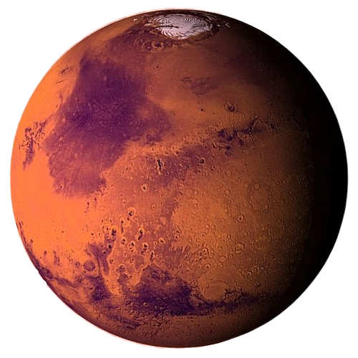

It might have had life?
01
Day Length
Studying Mars helps us understand if life ever existed there, and maybe even how life began on Earth, Despite their differences, Earth and Mars share surprising similarities.
02
Presence of Water
03
Potential for Life

Slide 5

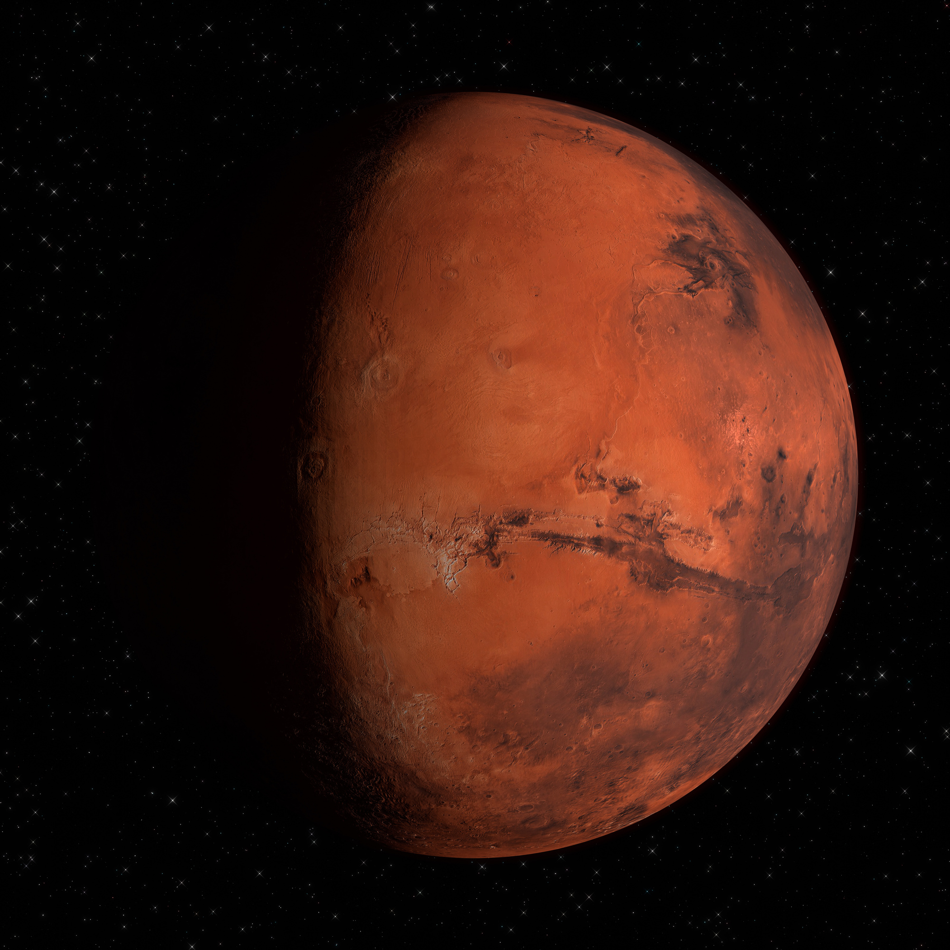

Physical Characteristics
Size: Mars is about half the size of Earth, with a diameter of approximately 6,787 kilometers (4,221 miles).
Mass: Mars has about one-tenth the mass of Earth.
Surface: The Martian surface is diverse, with features like:
Craters.
Volcanoes.
Canyons.
Polar ice caps.

Slide 6


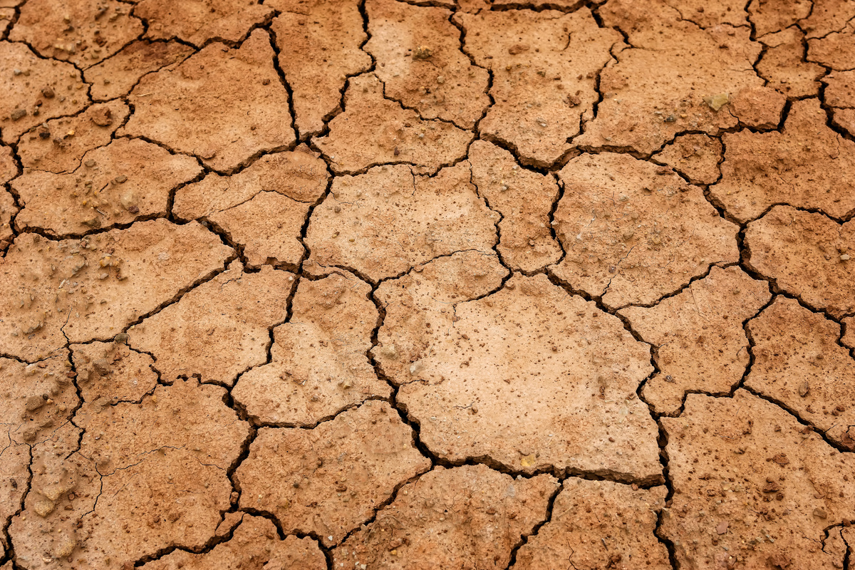
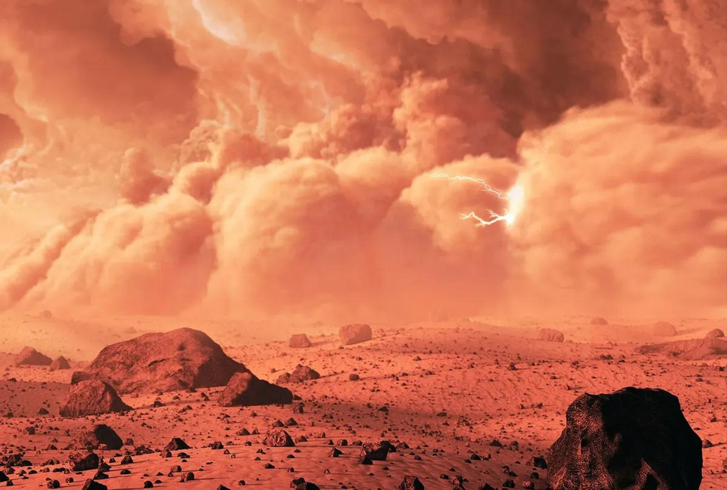
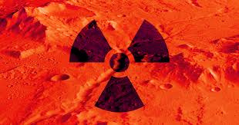
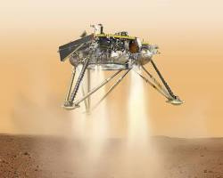
Challenges of Human Exploration to Mars
challenge 01
challenge 02
challenge 03
challenge 04
Terrain Navigation
Environmental Resilience
Radiation-resistant electronics
Technological Advancements

Slide 7



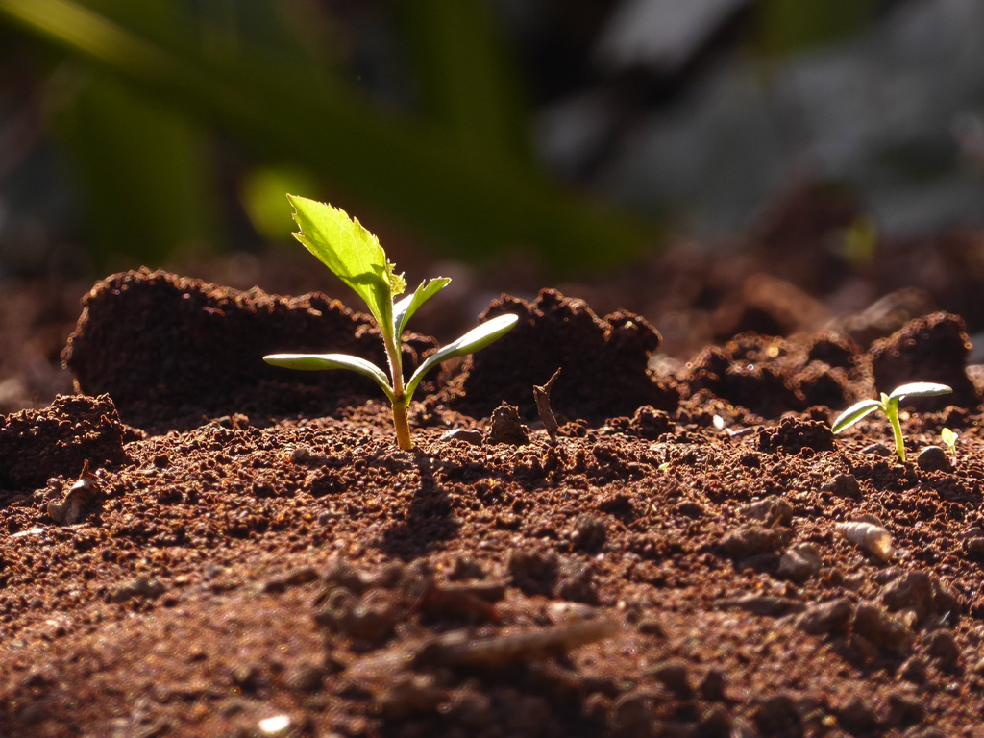
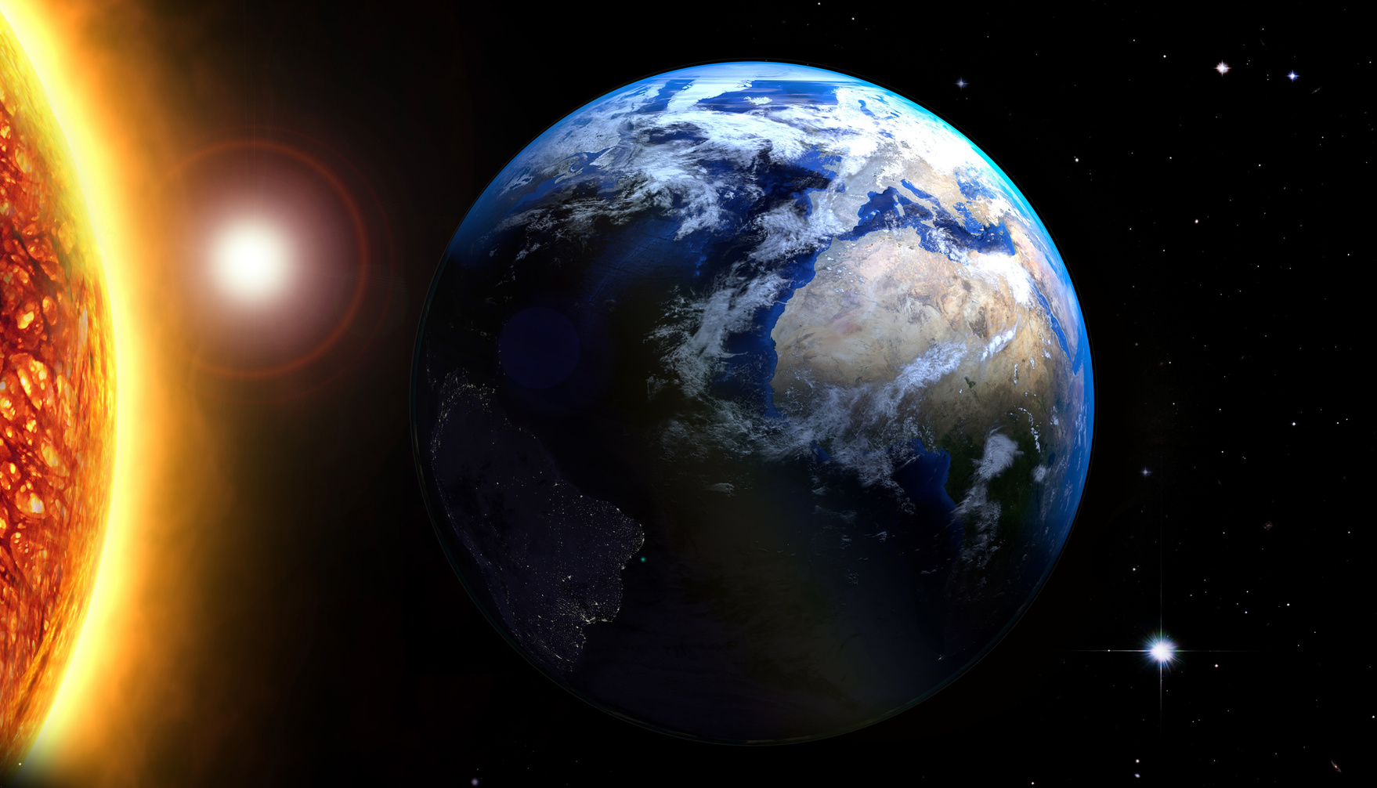
01
03
The Martian surface is littered with rocks, craters, and dunes, making navigation and obstacle avoidance a major challenge for rovers.
Mars lacks a strong magnetic field to shield it from harmful solar radiation, posing a significant risk to rover electronics and instruments.
02
04
Martian dust storms can be intense and long-lasting, obscuring the sun and blocking solar energy needed to power the rovers and life support systems.
Rovers must operate largely autonomously due to the communication delay, requiring advanced onboard processing and decision-making capabilities.

Slide 8



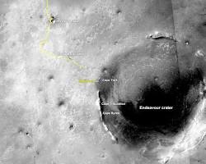

Landing Site Selection
Victoria Crater
Victoria Crater offered a unique combination of scientific potential and operational feasibility, making it an ideal landing site for the Opportunity Rover to study the Martian volcanic history, search for evidence of past water activity, and investigate the geological processes that shaped the red planet.
Science:
Engineering:
Operational considerations:
Geological and mineralogical diversit.
Astrobiological potential
Accessibility of key scientific targets
Landing safety
Solar energy availability
Atmospheric conditions
Communication visibility
Distance to other missions
Planetary protection

Slide 9

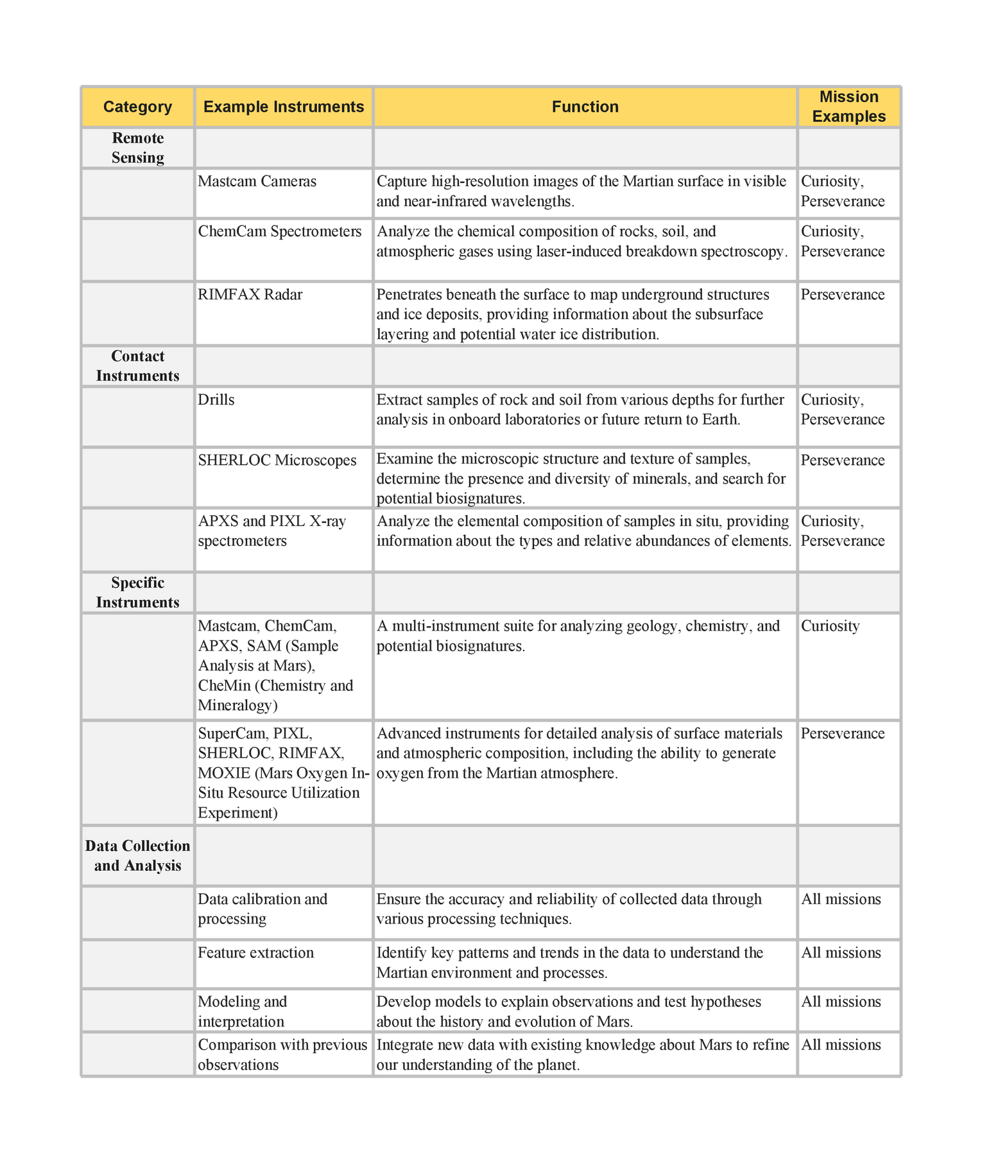

Detailed Table of Scientific Instruments and Equipment on Mars Rovers

Slide 10


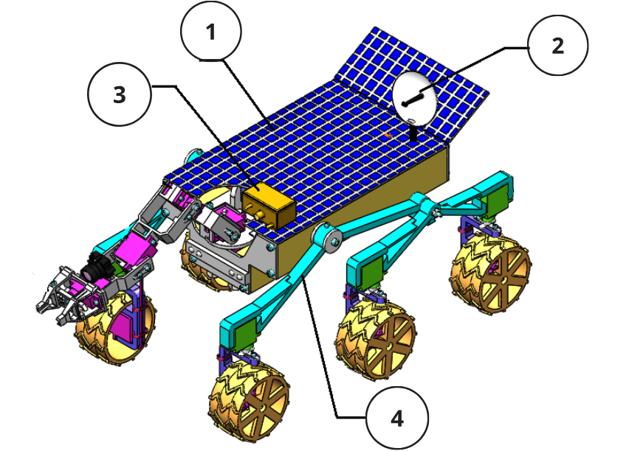
Terrain-Adaptive Martian Investigation Rover (TAMIR)
01
Self-cleaning solar panels
02
High-bandwidth laser communication system
03
LiDAR (Light Detection and Ranging) camera
04
six-wheel rhombus-arranged mobility system

Slide 11

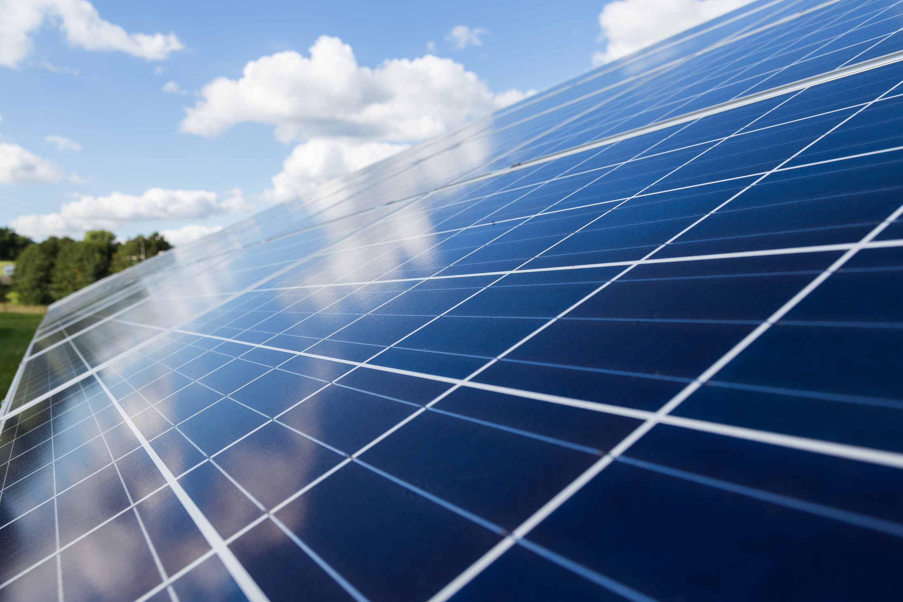




01
Self-cleaning solar panels automatically remove dust and dirt, ensuring high energy production and maximizing efficiency.
Benefits:
Increased efficiency, especially in dusty environments
Reduced maintenance costs
Extended lifespan
Environmentally friendly
Challenges:
Cost
Durability
Initial efficiency

Slide 12

02
The Institute of Electrical and Electronics Engineers (IEEE) plays a critical role in driving the advancement and adoption of HBLCS for space applications. Through its diverse initiatives, IEEE fosters an ecosystem that empowers researchers, engineers, and industry leaders to unleash the full potential of HBLCS and propel space exploration forward.
High-Bandwidth Laser Communication System (HBLCS).
Benefits:
Faster data transmission
Real-time communication
Enhanced security
Increased efficiency
Challenges:
Atmospheric interference
Pointing and tracking
Optical components
Standardization

Slide 13

03
Equip the rover with a variety of sensors, including cameras, LiDAR, and spectrometers, for data collection and environmental analysis. Implement hazard detection sensors to identify obstacles and potential dangers.
Advantages:
High accuracy and resolution, even in low-light conditions.
Can penetrate thin vegetation and dust.
Works well for mapping large areas.
Disadvantages:
Relatively expensive compared to other camera options.
May not be able to detect very low obstacles, such as small rocks or holes

Slide 14
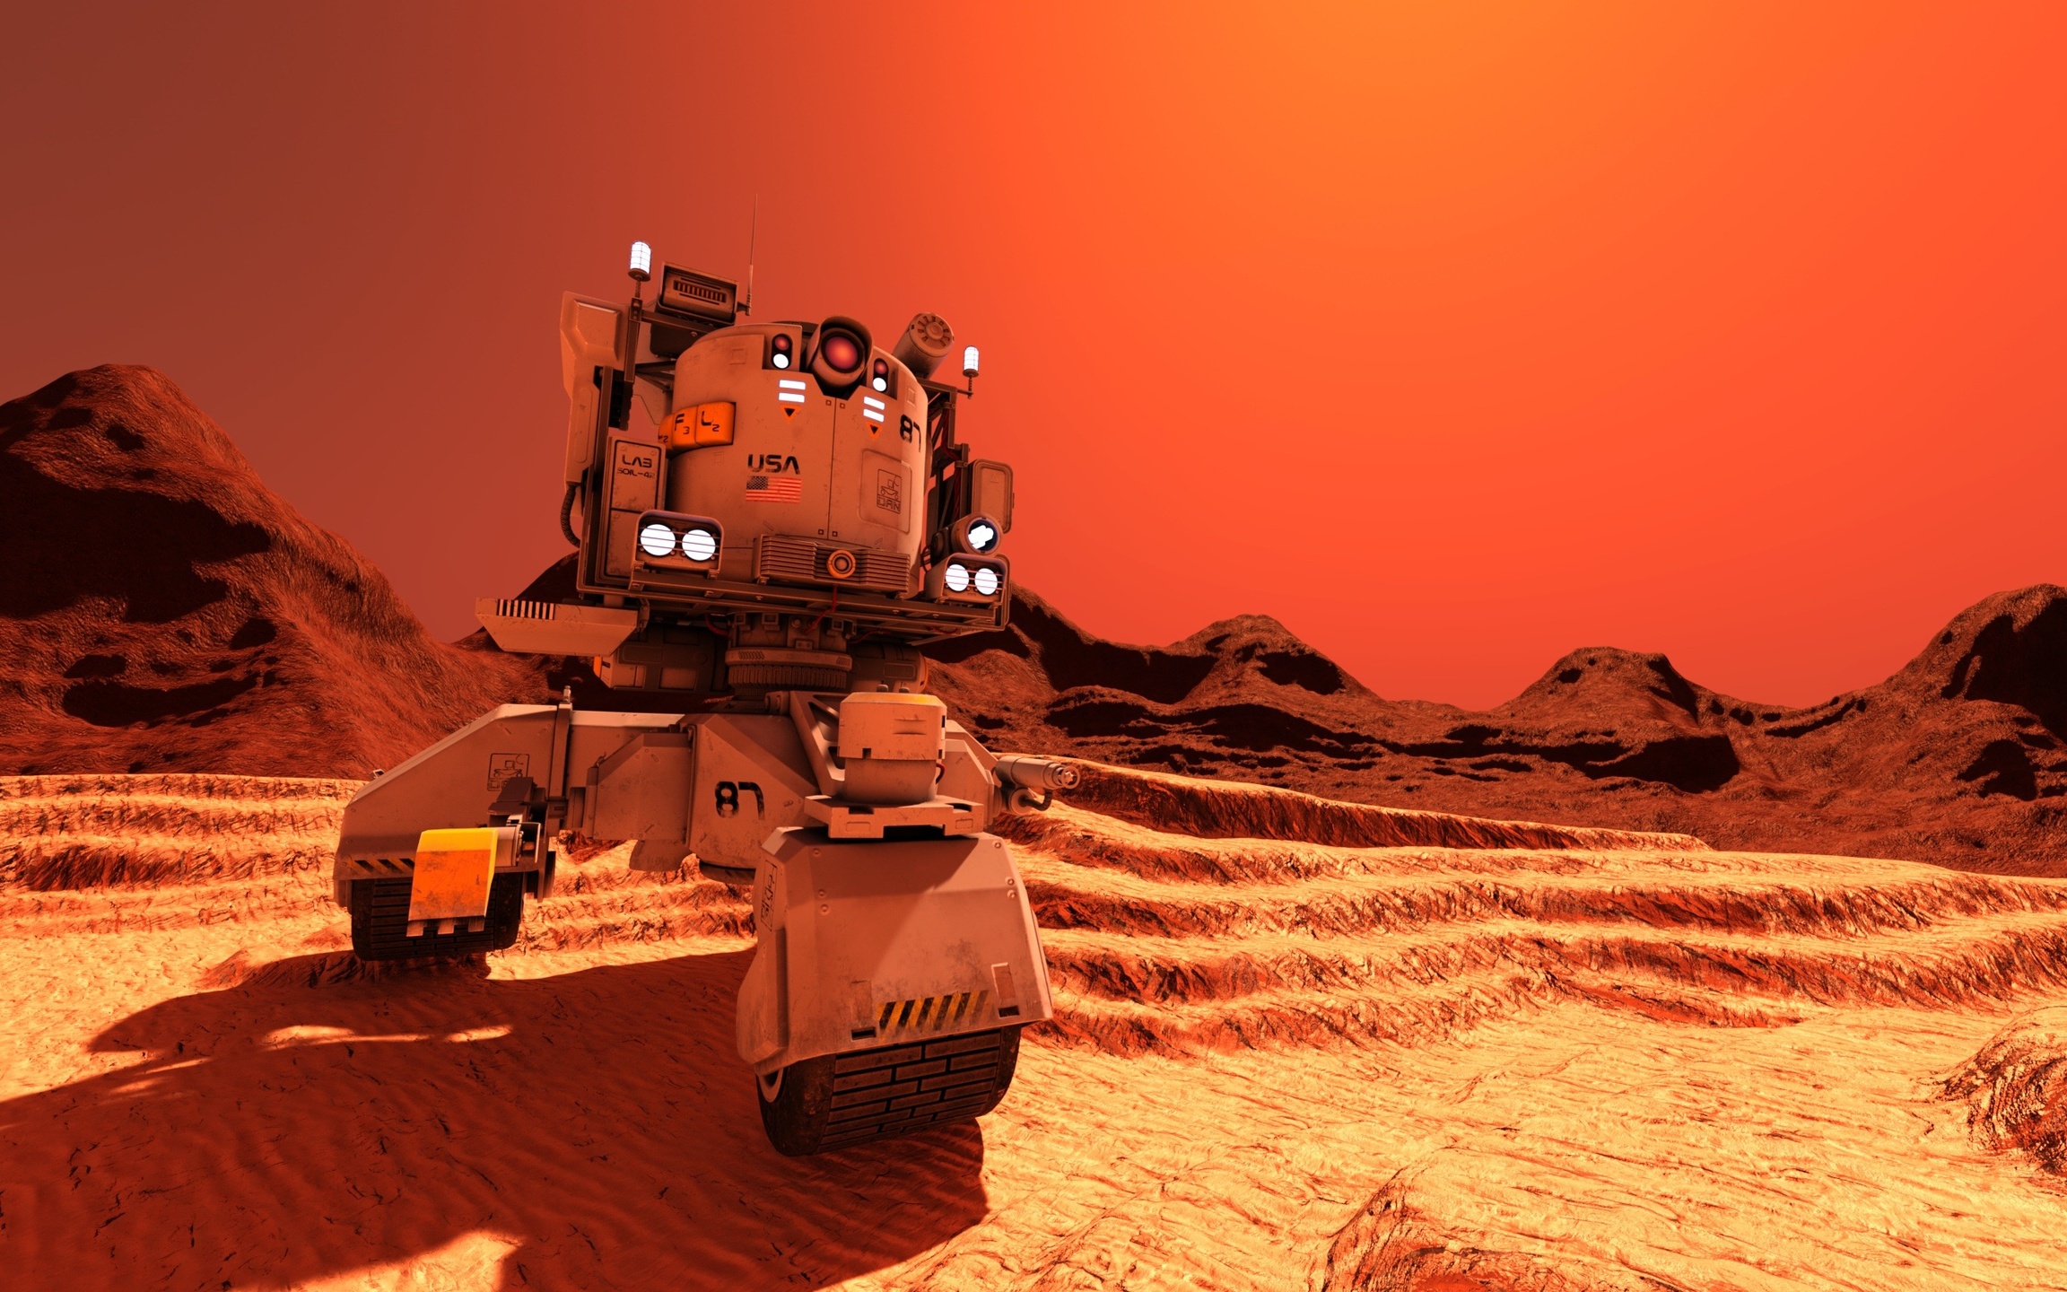
04
Six-Wheel Rhombus Mobility System
Benefits:
Increased stability on rough terrain.
Improved maneuverability in tight spaces.
Enhanced obstacle avoidance.
Potentially lighter and simpler design.
Larger payload capacity.
Challenges:
More complex design and control system.
Possibly higher cost.
Requires extensive testing and validation.
Limited availability currently

Slide 15

Conclusion & Perspectives
Technological advancements, from high-bandwidth laser communication to six-wheel rhombus rovers, promise a transformative era of space exploration. These innovations will unveil the mysteries of the universe, expand the frontiers of human exploration, and enable a deeper understanding of our place in the cosmos.

